Slide 1
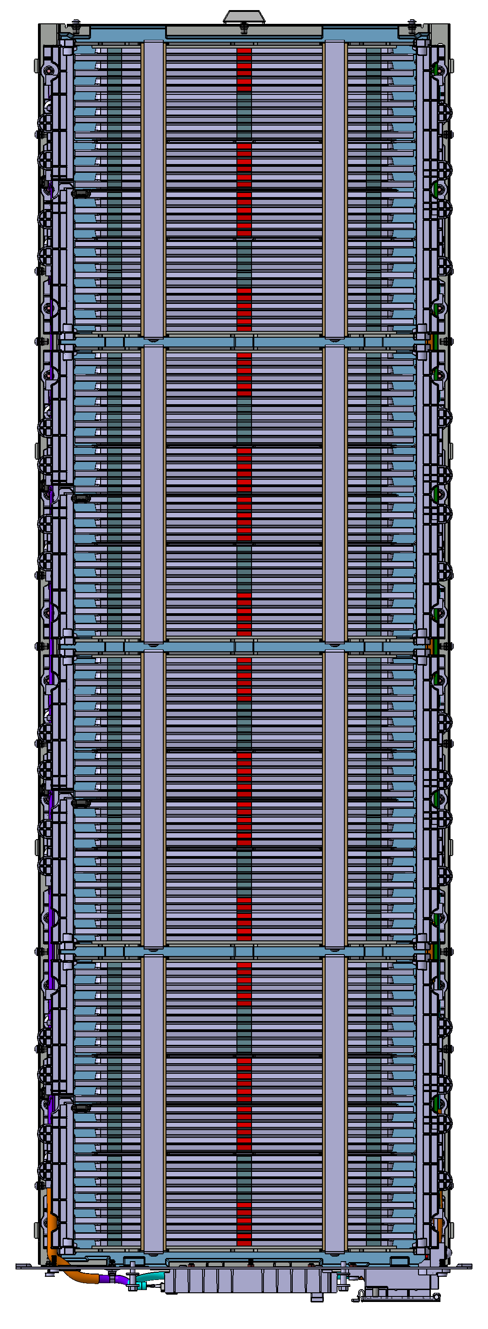
Capacity Retention
Test item | Reference | Test Condition | Test Result
Temperature Operating Test | Spec | ▶ Test Ambient Temperature : 25℃ ▶ Pattern: charge : 1.0CP to 86.4V (Cell 3.6V) rest : 2hr discharge : 1.0CP to 64.8V (Cell 2.7V) rest : 8hr 1-cycle | Charge Capacity : 168.35Ah (63min 25sec) Charge Energy : 13868Wh Discharge Capacity : 167.15Ah (57min 46sec) Discharge Energy : 12632Wh
Cell Max Temperature [℃]
T max : 47.6℃
41.95 | 43.45 | 42.95
45.00 | 45.90 | 44.55
46.35 | 47.35 | 46.40
46.65 | 47.60 | 46.75
46.35 | 47.05 | 45.65
44.80 | 44.95 | 42.55
T16
Charge
Rest
Discharge
Rest
T8
Test Result
 | Max Temp[℃] | Average Temp[℃]
T8 (Max) | 47.60 | 30.50
T16 (Min) | 41.95 | 27.06
△T (Max-Min) | 5.65 | 3.77
Top View

